Slide 1
DAN602: Statistics for Data Analytics
Rob Harbert

Slide 2
Welcome!
Schedule:
9:30 – 10:20 DAN 602 – Welcome & Introductions
10:45-11:00 – Deb Salvucci
11:00 – 12:00 – Library Tour (Heather Perry)
12:00 – 1:00 DAN602 – Discussion: What are we trying to do with statistics?
1:00 – 2:00 Lunch
2:00 – 4:00 DAN602 – SAS Studio orientation (import & visualize data)

Slide 3
About me

Slide 4

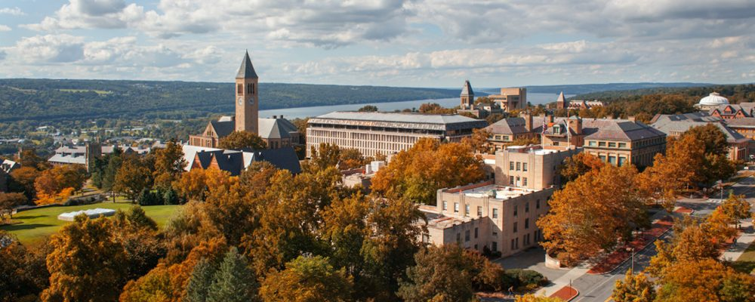

Academics (too many years in school)
B.S. Biology from Roanoke College
Ph.D. Plant Biology @ Cornell University

Slide 5

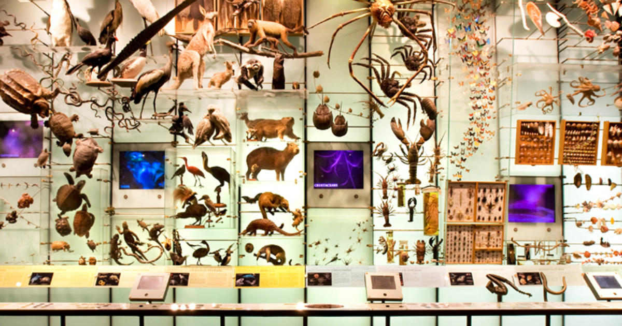
American Museum of Natural History

Slide 6

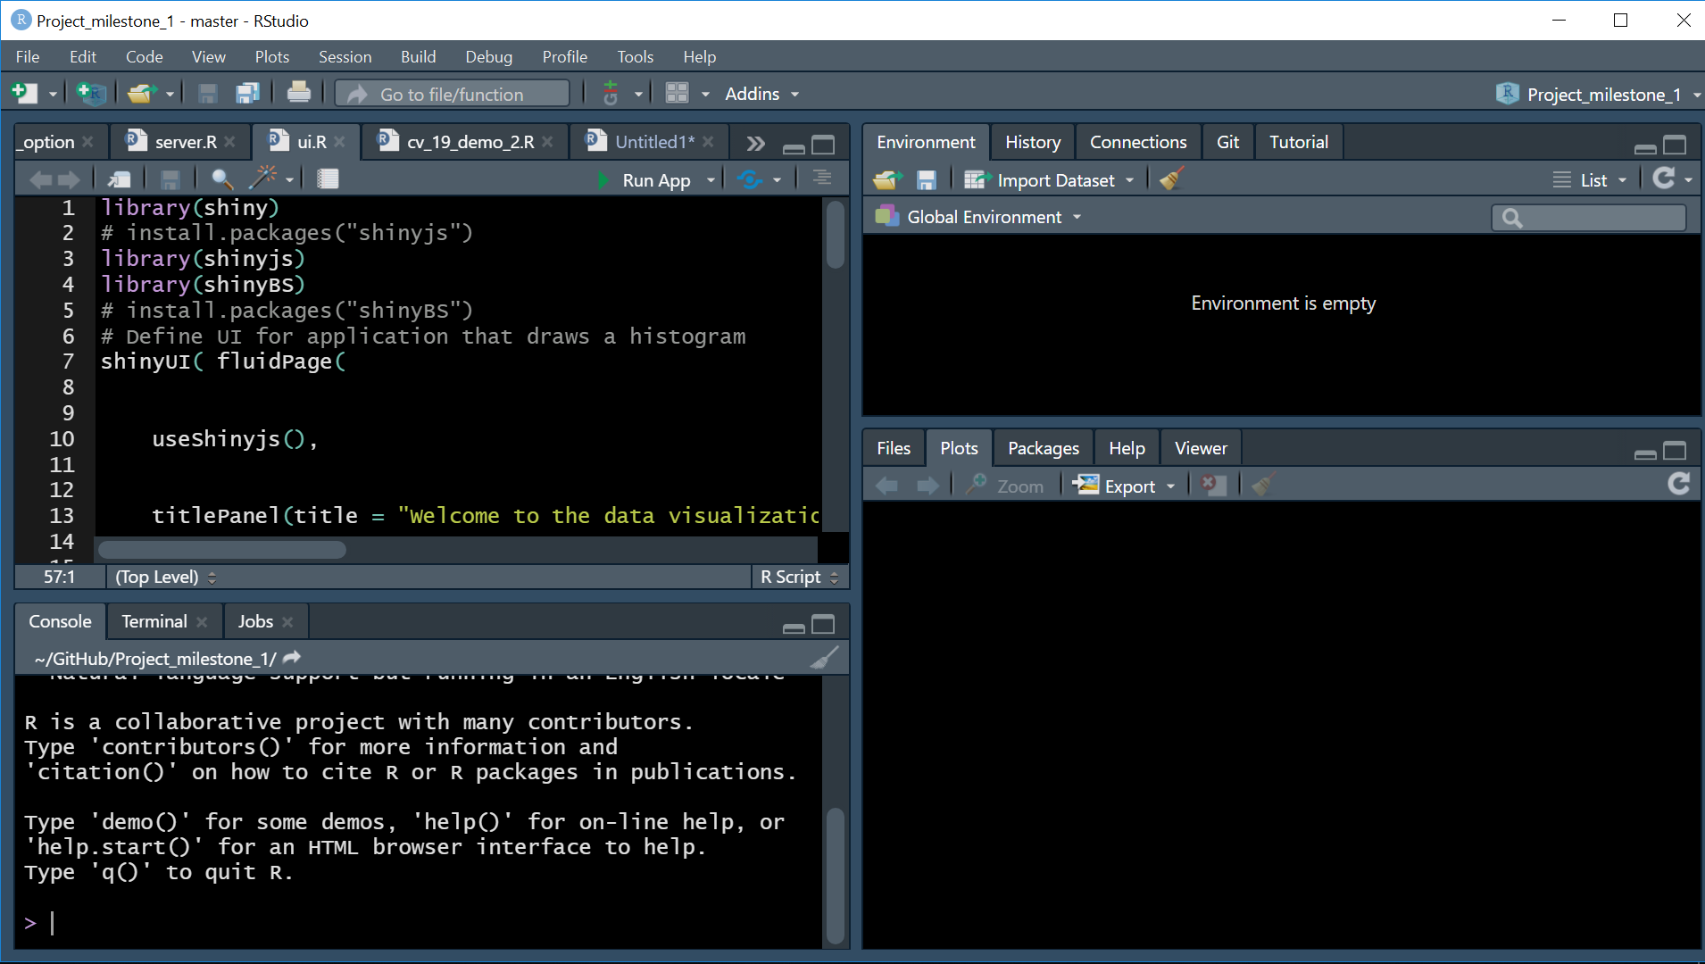
American Museum of Natural History

Slide 7
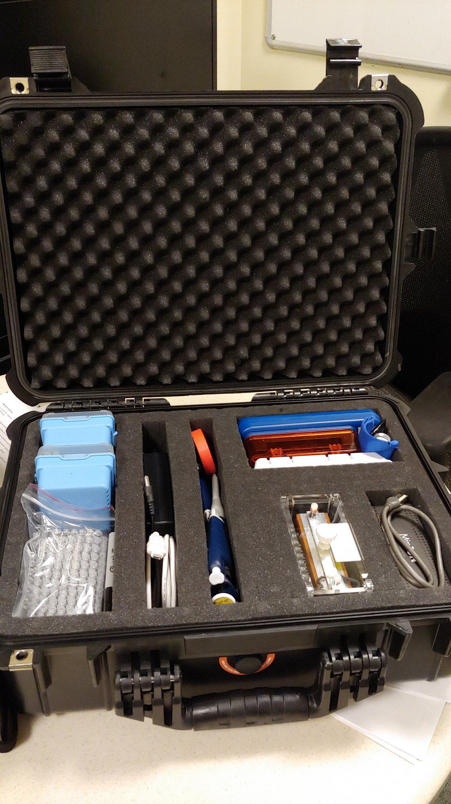
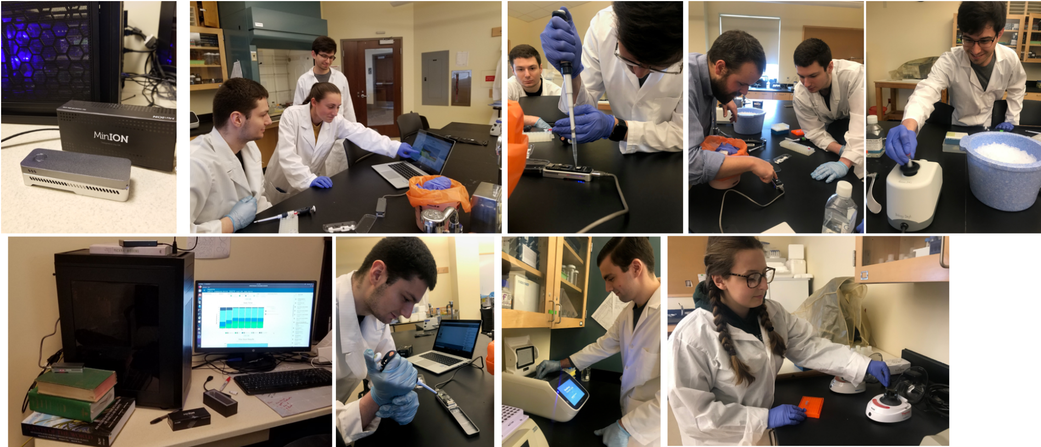
@ Stonehill College
BIO 101/102 – Bio Principles
BIO 261 – Biostats
BIO 331/332 – Bioinformatics
BIO 303 – Botany
DAN 602 – Statistics
Research @ http://devbioinformatics.org/
R/python/bash/C++
Metagenomics
Ecological & Climate modeling
GPU Acceleration

Slide 8
About you

Slide 9
Introductions
Who, what, where (are you coming from)?
Why (MPS)?
What do you want to learn from this class?

Slide 10
DAN 602
eLearn
Books
Use Slack!
Zoom office hours

Slide 11
Questions
?

Slide 12
BREAK until 10:40

Slide 13
Discussion: What are we trying to do with statistics?
Or: “Lies, damned lies, and statistics” – Mark Twain, et al.

Slide 14
Statistics
the science that deals with the collection, classification, analysis, and interpretation of numerical facts or data, and that, by use of mathematical theories of probability, imposes order and regularity on aggregates of more or less disparate elements. (dictionary.com)
A “science” ->
Collection, classification (organization), analysis, and interpretation
Numerical facts or data
PROBABILITY
WTF? “imposes order and …”

Slide 15
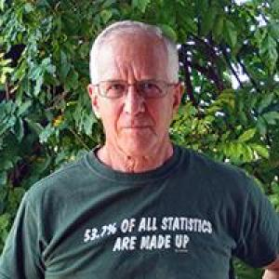
BUT…
Statistics is done by humans
And humans have an agenda
Numbers always sound real
But should be critically examined
Most people don’t really care about facts.
This guy ^^ wrote your textbook

Slide 16
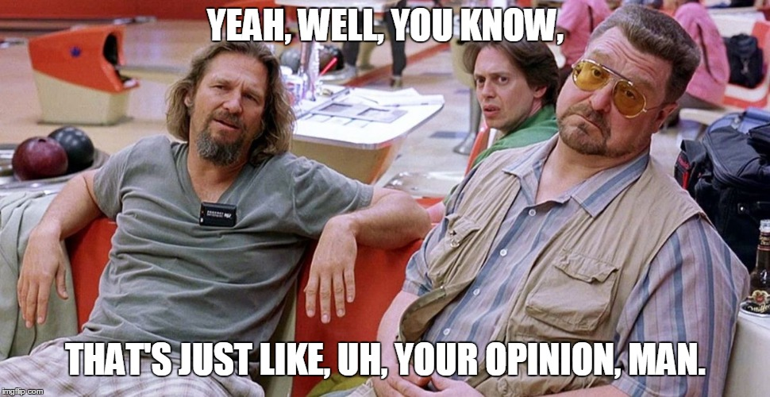

Slide 17
What are we trying to do?
Apply statistics in an objective and accurate manner
Understand statistical theory
Develop practical analysis skills (descriptive and inferential stats in SAS)
Apply to real data
Be critical of our methods and those we see

Slide 18
Statistics is…
A scientific process (observe, hypothesize, collect data, test, interpret)
Objective
*but see Twain
Requires data
Requires probability
Requires interpretation

Slide 19
Time to practice…

Slide 20
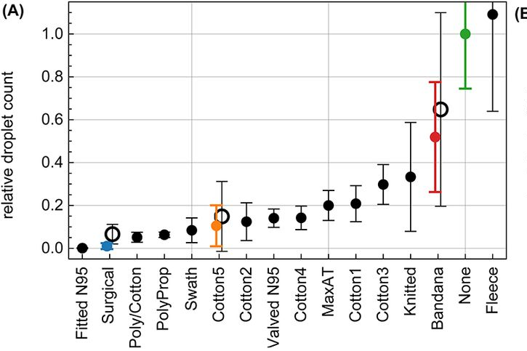
Stats: Which masks are best?
Droplet transmission through face masks. (A) Relative droplet transmission through the corresponding mask. Each solid data point represents the mean and standard deviation over 10 trials for the same mask, normalized to the control trial (no mask), and tested by one speaker. The hollow data points are the mean and standard deviations of the relative counts over four speakers.

Slide 21
The CDC noted that "For 6% of the deaths, COVID-19 was the only cause mentioned."
So… it’s just people with pre-existing illness dying, right?

Slide 22
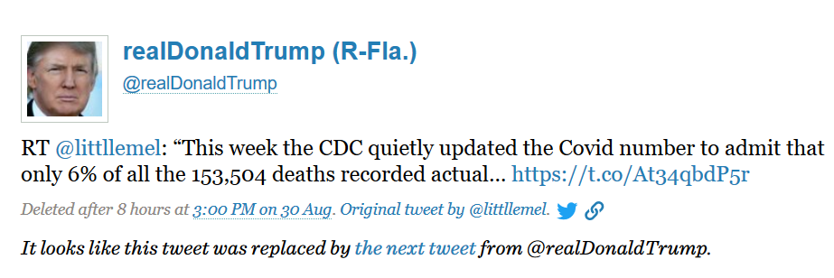
The CDC noted that "For 6% of the deaths, COVID-19 was the only cause mentioned."
So… it’s just people with pre-existing illness dying, right?

Slide 23
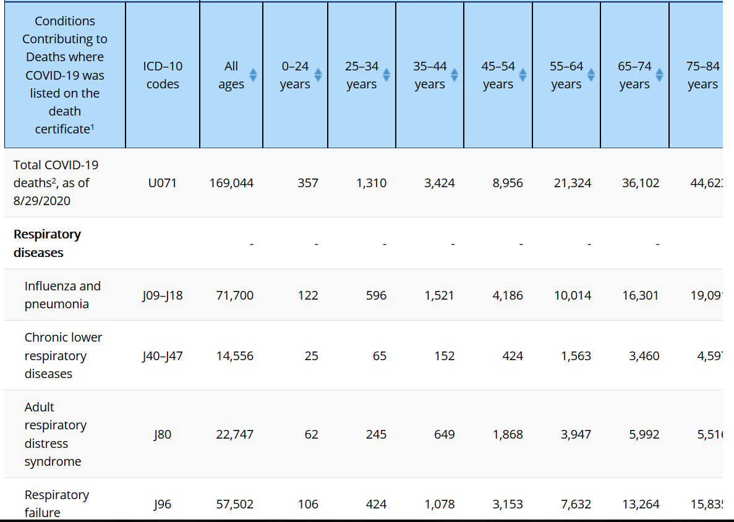
The CDC noted that "For 6% of the deaths, COVID-19 was the only cause mentioned."
https://www.cdc.gov/nchs/nvss/vsrr/covid_weekly/index.htm#Comorbidities

Slide 24
Good analysis here:
https://www.livescience.com/covid-19-comorbidities.html

Slide 25
Video #1: The “best” stats video…
Trends in Child Mortality – https://youtu.be/hVimVzgtD6w
What is the question?
What are the data?
How are we being lead to draw conclusions?
Map the whole argument →

Slide 26
Video #2: Steven on car seats
Steven Levitt on Child Car Seats -- https://www.youtube.com/watch?v=um5gMZcZWm0&feature=share
What is the question?
What are the data?
How are we being lead to draw conclusions?
Map the whole argument →

Slide 27
Lunch

Slide 28
SAS Studio Orientation for Stats
Download and import data for book exercises
Practice descriptive stats and basic visualization
Import data from a CSV file

